Slide 1
Pre-Listing Inspection Program
Our Pre-Listing Inspection Program is the best way to sell or buy a home,
and we can show you why.
When we take the home inspection from the end of the transaction
and use it as a tool at the beginning, several benefits become available
for sellers and buyers
that otherwise don’t exist during a traditional transaction.

Slide 2
Typical Transaction
Buyer and seller enter into contract
Short option period
Schedule home inspection
Buyer’s response to home inspection
Find contractors
Get quotes
Make repairs
High stress!
Unexpected costs
Transaction cancels

Slide 3
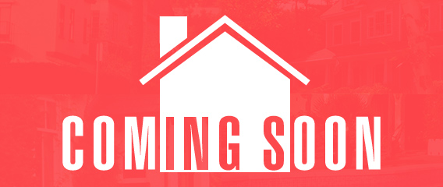
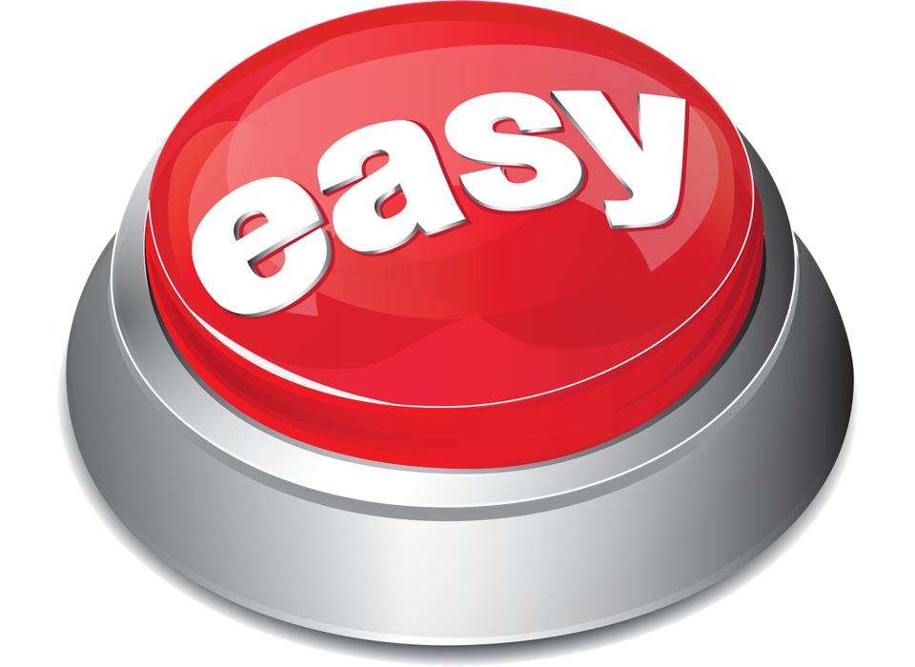
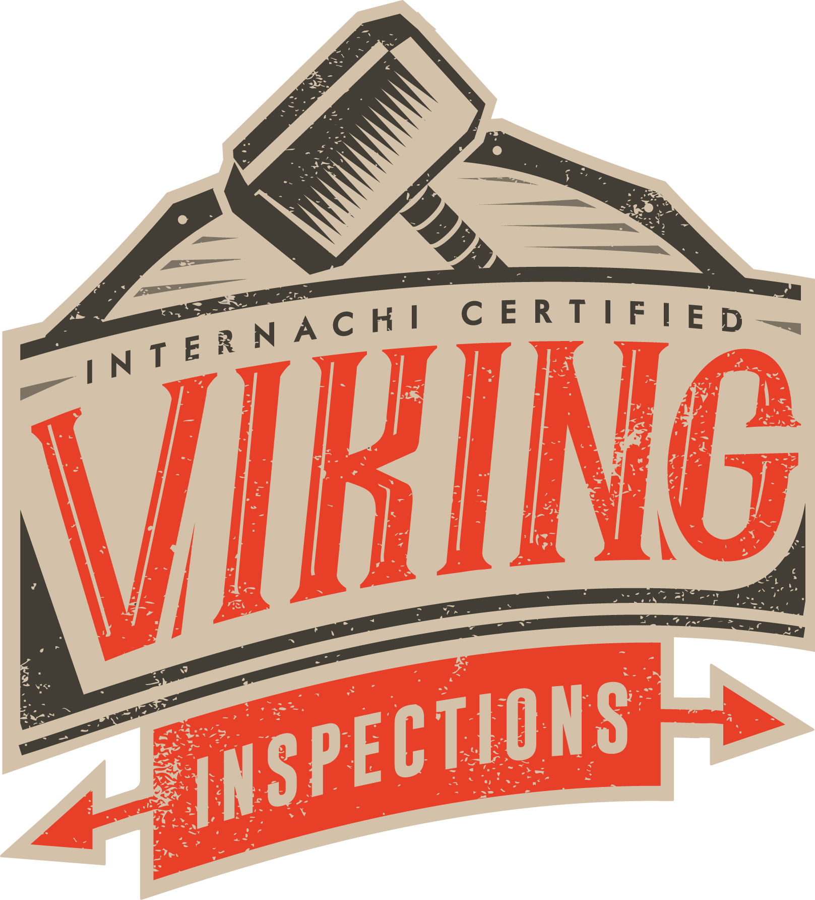
Pre-Listing Inspection Program Transaction
Home and wood destroying insect inspection performed by Viking Inspections prior to listing (1 year structural warranty and 5 year roof leak warranty provided)
Make repairs on your terms
Include premium 18 month home warranty
Include cost of repairs and home warranty into price of home
Price property accordingly and place on market
Provide inspection reports, warranty, repair list, and full disclosure letter to prospective buyers and agents
Accept offer
Close
Enjoy your new life chapter!
PRE-INSPECTED!
5 YEAR ROOF PROTECTION
Pre-Inspected By
INCLUDES
18 MONTH HOME WARRANTY

Slide 4
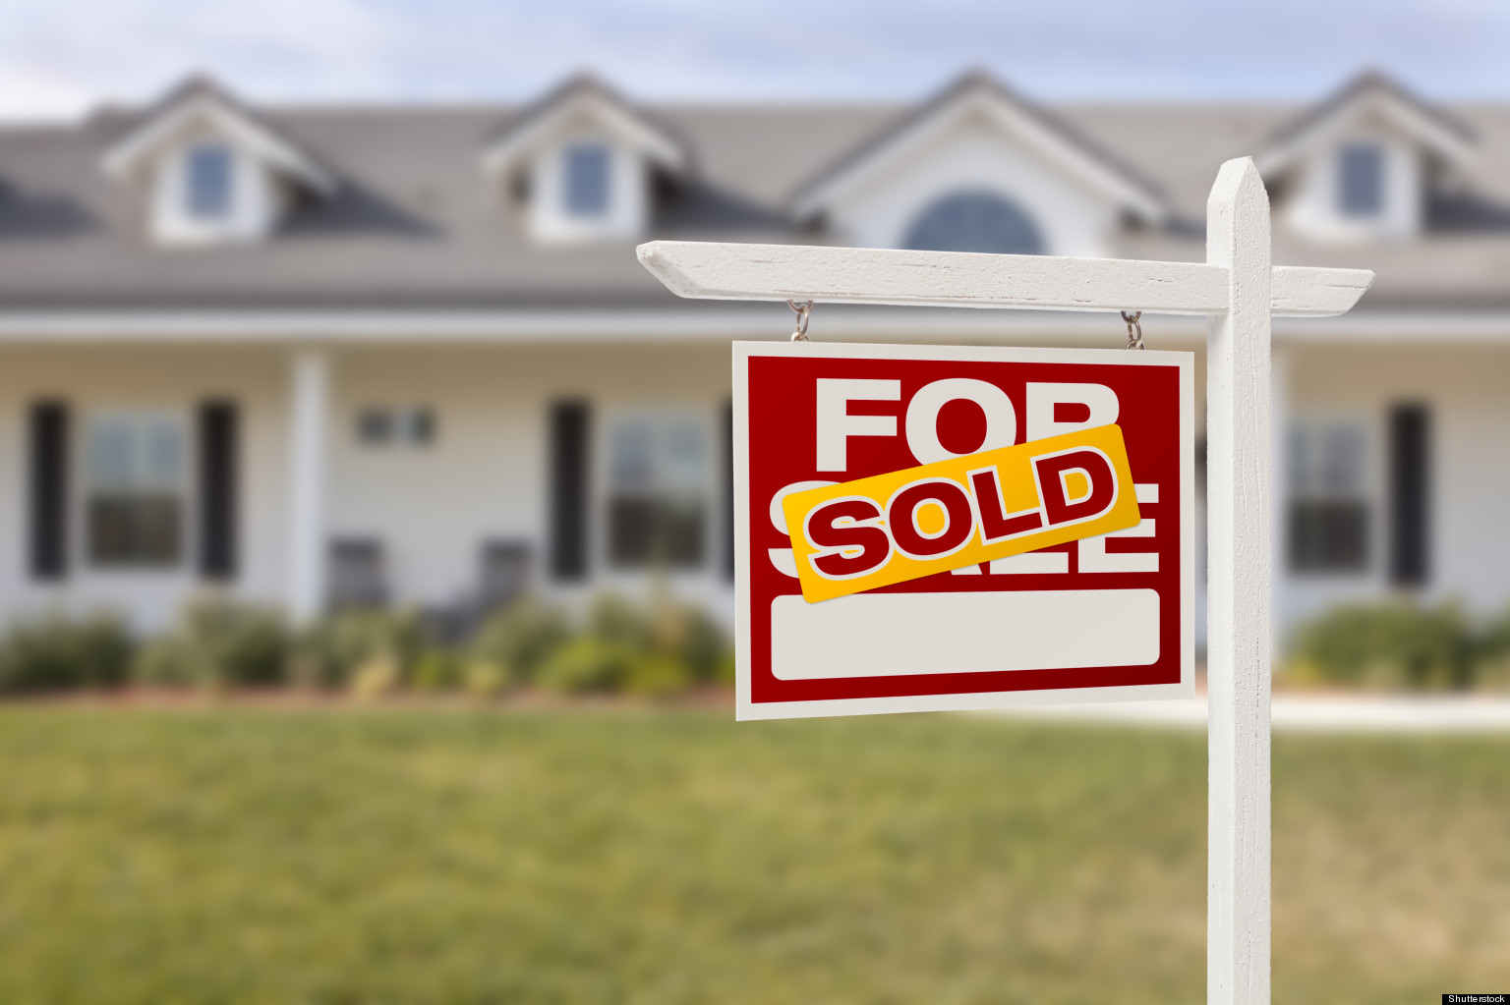
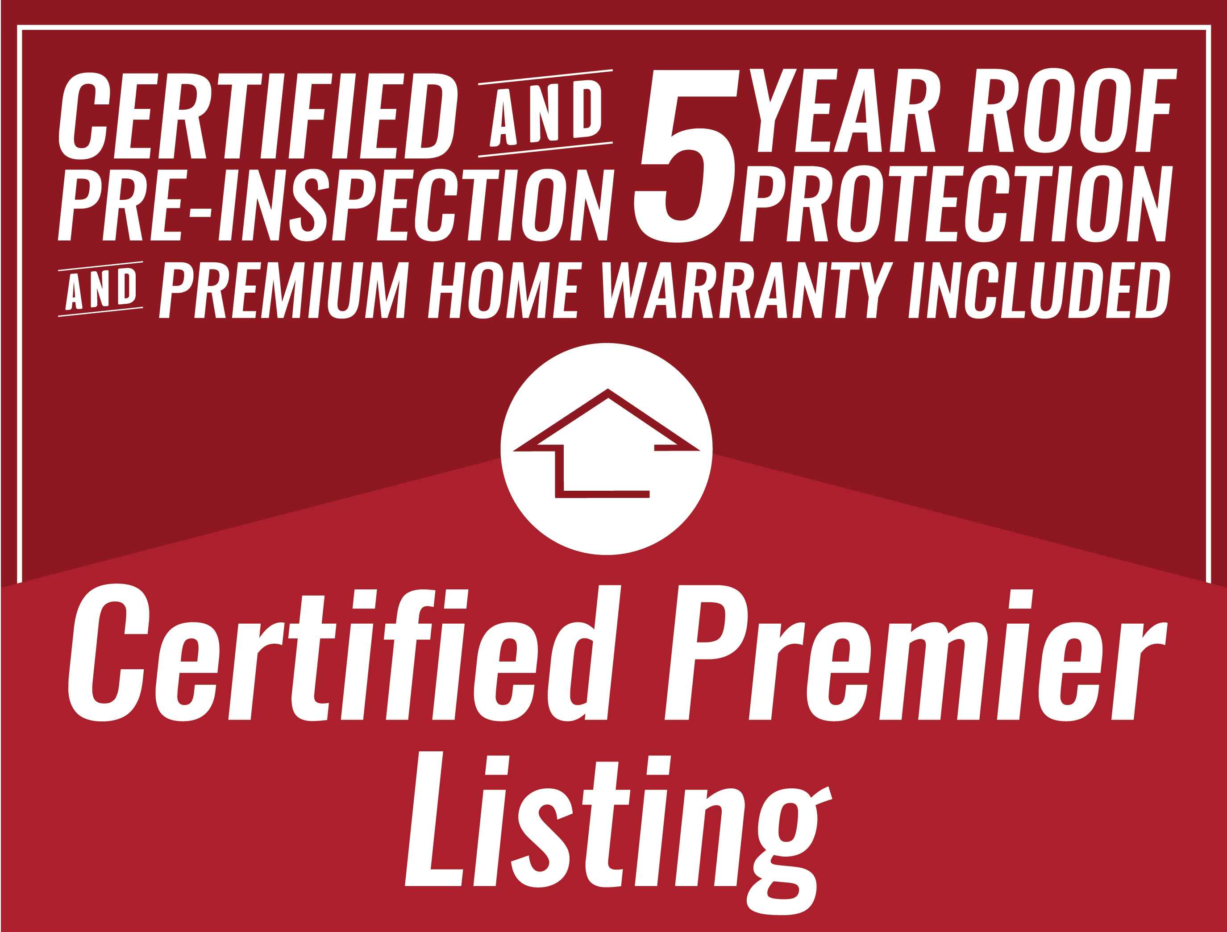
Seller Benefits
Eliminate fall throughs
Make less mortgage payments!
Gain full picture of property condition
Protection from unforeseen costs
Shop for best pricing on repairs
Make your own repairs
Build repair costs into price of home
Home priced accordingly
Repair on YOUR TERMS instead of during limited option period
No re-listing due to fall throughs
Full disclosure letter provided to prospective buyer/agent
Repair amendment virtually eliminated
Renegotiation during option period disappears
Don’t pay for warranty until closing
Enjoy benefits of warranty coverage during listing period
Enjoy discount from Viking Inspections if used during next home purchase
Less stress
Truly a better way to sell a home!

Slide 5
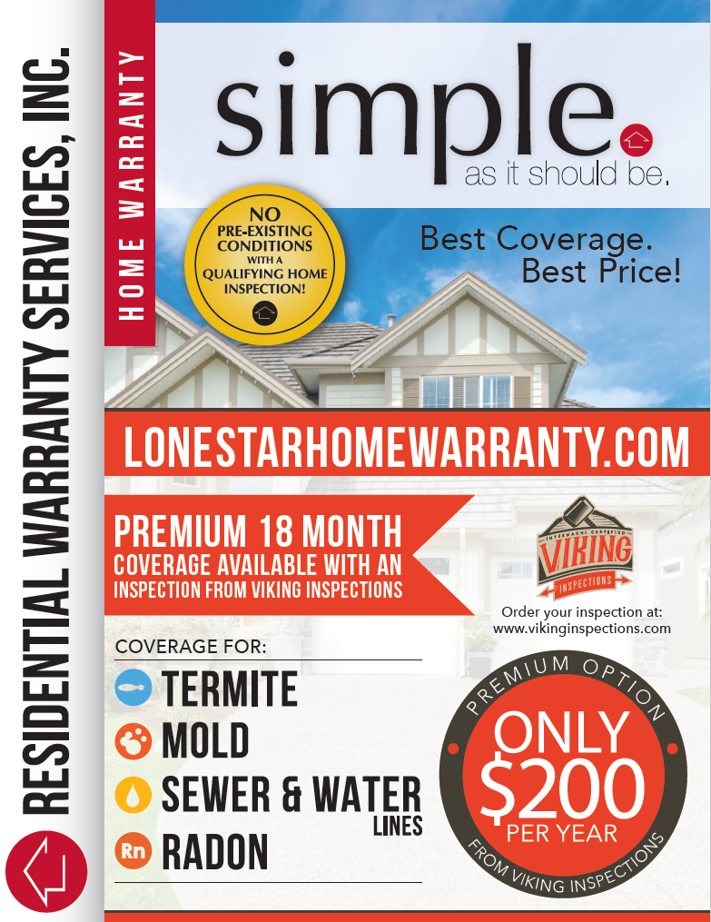
Buyer Benefits
Eliminate fall throughs
Repair amendment virtually eliminated
Renegotiation during option period disappears
Access to full disclosure of property condition, inspection reports, and repairs made
Understands condition of property prior to making an offer
Protects buyer from being blindsided with unexpected problems
Protection from inaccurate repair estimates
Offer made accordingly
Spend less on inspection fees, appraisals, and other testing
Less stress!
Enjoy benefits from 1 year structural warranty
Enjoy benefits from 5 year roof protection
Enjoy benefits from premium 18 month home warranty
Peace of mind
Truly a better way to buy a home!

Slide 6
I believe in this
Pre-Listing Inspection Program
so much that if you list with me
your inspection is FREE!

